Slide 1

Project Name
Problem Statement: PS-XX
Domain: Healthcare / Education / AI / FinTech / etc.
Team [TEAM NAME]
Member 01 · Member 02 · Member 03 · Member 04
HACK
MATRIX

Slide 2

The Problem
Short explanation.
Short explanation.
Short explanation.
Who is affected?
Primary Users → Secondary Stakeholders → Broader Impact
Problem Statement ID: PS-XX

Slide 3
WHY THIS PROBLEM EXISTS
Cause 1
Cause 2
Cause 3
->
CORE PROBLEM
->
USER CONSEQUENCE
->
REAL IMPACT
Current Approach:
Current Method → Friction → Delay / Cost / Risk → Poor Outcome

Slide 4
OUR SOLUTION
INTRODUCING [PROJECT NAME]
[Project Name] enables [target user] to [desired outcome] by [unique mechanism].
Then show your solution visually.
USER
↓
INPUT
↓
[YOUR SYSTEM]
↓
INTELLIGENCE / PROCESSING
↓
ACTIONABLE OUTPUT
↓
USER BENEFIT
Core capabilities
Capability Value
01 [Feature] [Why it matters]
02 [Feature] [Why it matters]
03 [Feature] [Why it matters]
Important: Don't put 8–10 features here. Three strong capabilities are more convincing than a feature dump.

Slide 5
PROTOTYPE / PRODUCT EXPERIENCE
Prototype Screenshots 1
Right: User journey
01 — INPUT
What the user provides.
↓
02 — PROCESS
What your system does.
↓
03 — OUTPUT
What the user receives.
↓
04 — ACTION
What happens next.
Prototype Screenshots 2
If you have only one prototype screenshot
Make it large, not tiny:
Input → Process → Outcome
Do not use a fake screenshot just to fill space. If the actual prototype isn't available yet, leave a clearly marked placeholder.

Slide 6
WHAT MAKES US DIFFERENT?
WHY THIS APPROACH?
Use a comparison matrix (Example below)
Existing Approach [Project Name]
Accessibility Limited ✓
Automation Manual ✓
Personalization Low ✓
Real-time feedback Limited ✓
Scalability Limited ✓
Only include dimensions that are actually defensible.
Avoid meaningless claims like "AI-powered, innovative and revolutionary."
If everyone uses AI, AI isn't your differentiator.

Slide 7
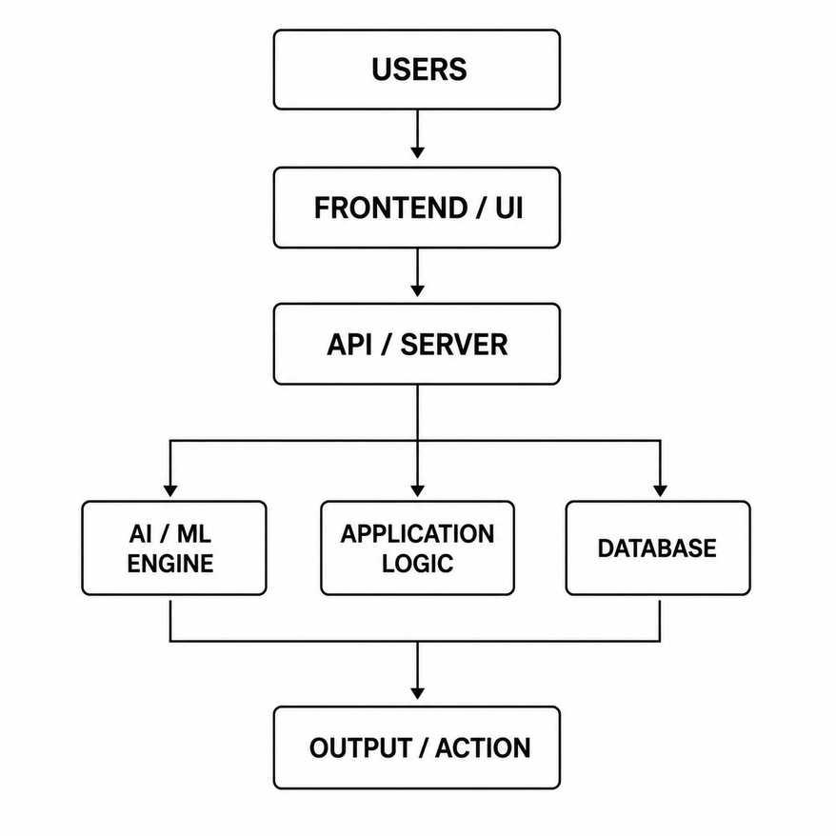
TECHNICAL ARCHITECTURE
Example Workflow Image
Tech stack:
Frontend
React / Next.js / Flutter / etc.
Backend
Node.js / Python / etc.
Database
PostgreSQL / MongoDB / etc.
AI/ML
Model / API / Framework
Deployment
AWS / Vercel / Azure / etc.
Only list technologies that are genuinely part of the implementation.

Slide 8
FEASIBILITY + IMPACT
FEASIBILITY
IMPACT
Technical
[Technology already available]
[Existing API/model]
[Implementation approach]
Operational
[Required resources]
[Deployment model]
Hackathon MVP
[What will actually be demonstrated]
Who benefits?
[User group]
What improves?
[Metric / outcome]
Why does it matter?
[Real-world consequence]
Then a bottom progression:
Prototype → MVP → Pilot → Scale

Slide 9
IMPLEMENTATION ROADMAP
WHAT HAPPENS NEXT?
NOW
Hackathon Prototype
Core workflow
Functional UI
Initial validation
NEXT
MVP
User testing
Reliability
Security
Refinement
LATER
Deployment
Real-world pilot
Analytics
Integrations
SCALE
Expansion
More users
More domains
More locations
Critical point
Clearly separate:
Already built
vs.
Planned

Slide 10
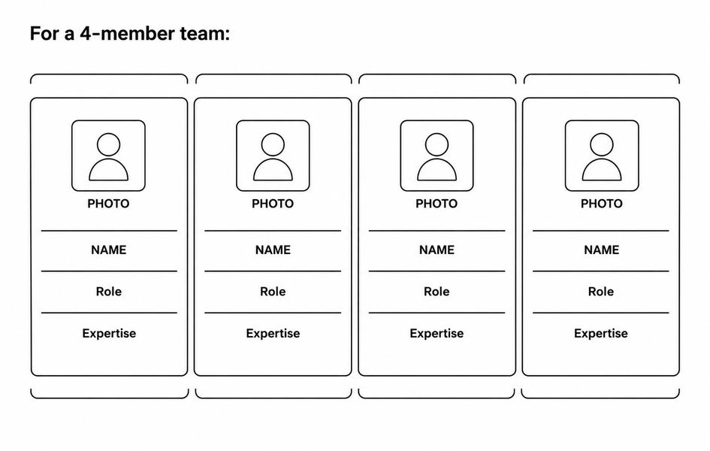
TEAM + EXECUTION
Example Image
Why this team can execute the solution
One concise sentence connecting the team's skills to the project.

